Slide 1
Event Management
01
02
03
04
Muhammad Subhan F2022266767
Hafiz Muhammad Abdulah Ijaz F2022266761

Slide 2
Scenario
01
02
03
04
01
02
03
Imagine you are planning a large corporate gala. You need to track various details about the event, including who is attending, where it's being held, and who is organizing it.
04
Creating the Event
Registering Attendee
Assigning the Venue
Managing the Organizer

Slide 3
Entities and Attributes
01
02
03
04

Slide 4

01. Events Entity
01
02
03
04
Event ID (Primary Key)
EventName
EventDate
EventTime
VenueID (Foreign Key)
OrganizerID (Foreign Key)
Description
Status (e.g. , upcoming , past , cancelled)

Slide 5

02. Attendee’s Entity
01
02
03
04
AttendeeID (Primary Key)
EventID (Foreign Key)
Name
Email
Phone
RegistrationDate

Slide 6

03. Venues Entity
01
02
03
04
VenueID (Primary ID)
VenueName
Address
Capacity
ContactPerson
ContactEmail
ContactPhone

Slide 7

04. Organizer’s Entity
01
02
03
04
OrganizerID (Primary Key)
OrganizerName
ContactEmail
ContactPhone

Slide 8
Relationships
01
02
03
04

Slide 9
01. Events Table
01
02
03
04
One-to-One with Venues Table: Each Event is held at one Venue (‘VenueID’)
One-to-One with Organizers Table: Each Event has one Organizer (‘OrganizerID’)
One-to-Many with Attendees Table: Each Event can have multiple Attendees (‘AttendeeID’)

Slide 10
02. Attendee’s Table
01
02
03
04
One-to-One with Events Table: Each Attendee is registered for one Event (‘AttendeeID’)

Slide 11
03. Venue’s Table
01
02
03
04
One-to-Many with Events Table: A Venue can host multiple Events (‘VenueID’)

Slide 12
04. Organizer’s Table
01
02
03
04
One-to-Many with Organizers Table: An Organizer can manage multiple Events (‘OrganizerID’)

Slide 13
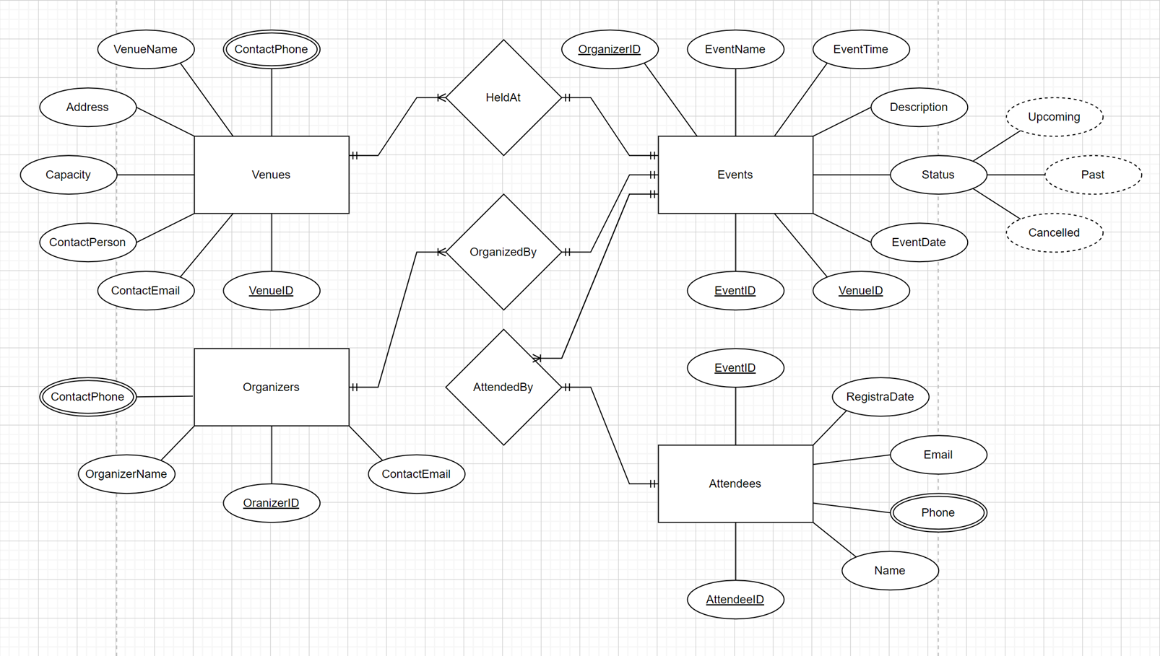
EDR Diagram

Slide 14

Event Management Interface
01
02
03
04

Slide 15
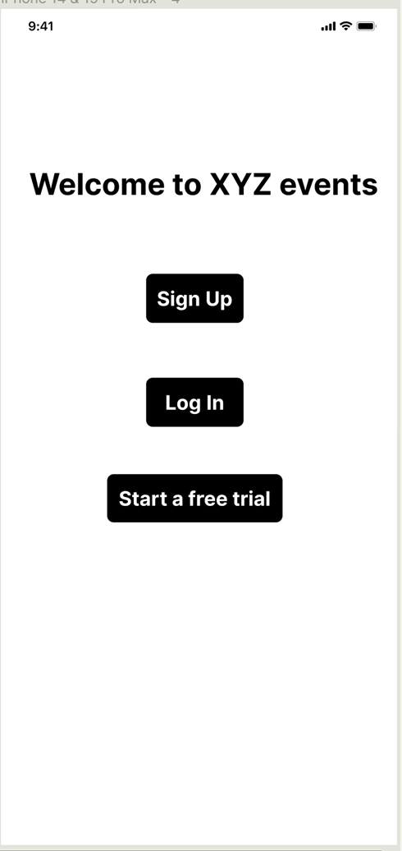
Event Management Interface
Welcome to XYZ, your ultimate solution for seamless event management. Whether you're organizing a small gathering or a large corporate gala, XYZ offers the tools you need to plan, manage, and execute your events with ease. Get started today.
Log In: Already have an account? Log in to access your personalized dashboard and manage your events.
Sign Up: New here? Sign up to create an account and start organizing your events effortlessly.
Free Trial: Not ready to commit? Try our free trial to explore XYZ powerful features and see how we can help you create memorable events.

Slide 16
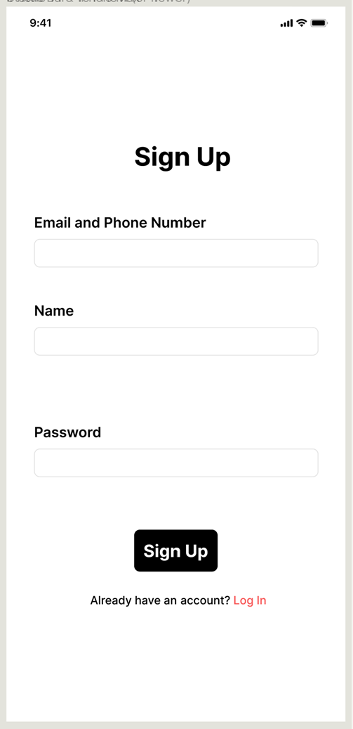
Event Management Interface
Create Your XYZ Account:
Join XYZ to start organizing your events with ease. Fill in the details below to get started.
Name:
Enter your full name.
Email:
Enter a valid email address.
Password:
Create a strong password.

Slide 17
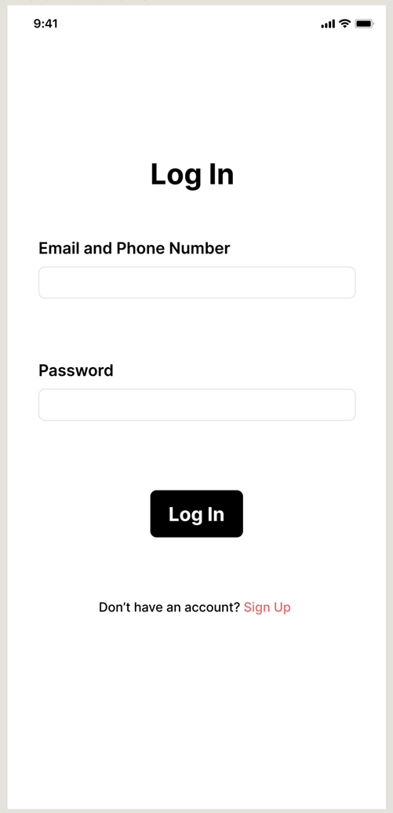
Event Management Interface
Log-In Page
Welcome Back to XYZ:
Log in to your account to access your personalized dashboard and manage your events seamlessly.
Email:
Enter your registered email address.
Password:
Enter your password.

Slide 18
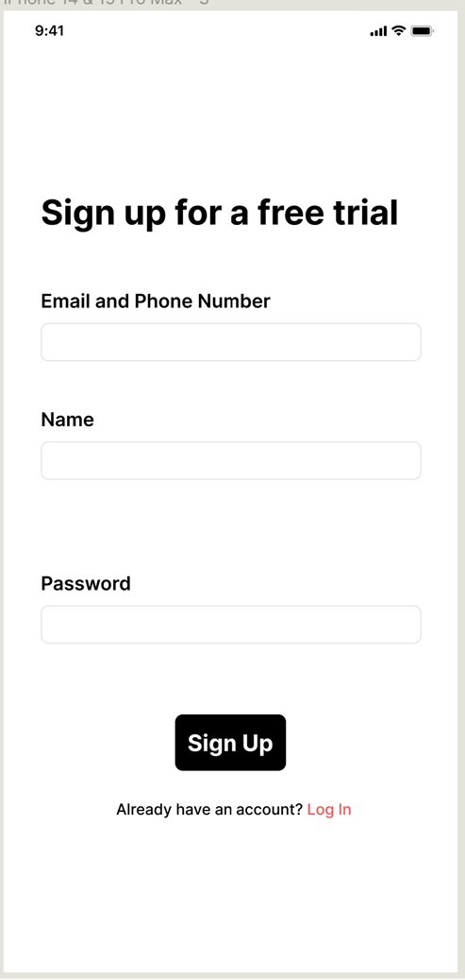
Event Management Interface
Free Trial Page
Start Your Free Trial with XYZ:
Experience the power of XYZ with a free trial. Fill in the details below to begin exploring our features.
Name:
Enter your full name.
Email:
Enter a valid email address.
Password:
Create a strong password

Slide 19
Comparison/Uniqueness
01
02
03
04

Slide 20
Comparison with other Website
XYZ VENUE HUB
LOGIN ✔ | LOGIN ✔
SIGN-UP ✔ | SIGN-UP ✔
FREE-TRIAL ✔ | FREE-TRIAL ✘

Slide 21
Comparison with other Website
We Added Free Trial option in our “Events management” as our unique option. We compared our website with another website called “VENUE HUB” whose link is given in reference page.
Unlike them; we offered our users “Free Trial” option. After Clicking “Free Trial”; he would need to enter his credit Card or Debit card Details which is absolutely compulsory. After that he can get “Premium offers” to see for “1 Week” completely free. He can see many more advanced features.
If he is satisfied with the results then he can buy our subscription for only “10 US Dollars” for a month after when free trial overs.
OR
He can Unsubscibe to our Offer; Incase he don’t like our “Premium Offers”.

Slide 22
References
01
02
03
04

Slide 23
Reference of “VENUE HUB”
After Clicking below link; You will directly go to VenueHub.
https://venuehub.pk/

